Slide 1
DAH2F3 Perencanaan Sumber Daya Perusahaan
Minggu ke-11: MySAP Technology
P r o d i D 3 K o m p u t e r i s a s i A k u n t a n s i F I T , U n i v e r s i t a s T e l k o m

Slide 2
AGENDA
Lesson: mySAP Technology
Client Server Architecture
Reference:
SAP. (2006). SAP01: SAP Overview. SAP AG.
The Database

Slide 3
Unit 7: mySAP Technology
Unit Overview
mySAP.com e-business platform is supported by an open integration architecture.
mySAP technology is build on fundamental industry standard to ensure openness and interoperability. (eq. HTTP, XML)
Flexibility framework in SAP allows to deliver e-business solution tailored to the needs of customer and their business partner.

Slide 4
Unit 7: mySAP Technology
Unit Objectives
Multi tier client/server concept
SAP client/server concept
Function client, client/server, server in software oriented view in SAP
Hardware system configuration
The purpose of client in term of mater, customizing, application data
Feature of development, a QA system, a production system and form of stage of live-system rollout
How business transaction related to system application
Requirement of entering in text field and assigning attribute
How table are used to identify the schematic and technical characteristics of fields
View the content of tables in SAP database
How table are used to generate specific information

Slide 5
Lesson: Client/Server Architecture
Lesson Overview
Concept of the client/server on which the SAP System.
Overview of how a user request is processed
Summary of data structure and outlines the transport between the system
Lesson Objectives
Describe the multi tier client/server concept
Describe how SAP uses the client/server concept
Outline function of a client, client/server, and server in the software-oriented view of the SAP systems
List the hardware system configuration
Define the purpose of client in term of master, customizing, and application data
Describe the feature of a development system, a quality assurance system, a quality and production system, as well as how they form the stages for live-system

Slide 6
Lesson: Client/Server Architecture
2
Views of client/server configuration
3
Process/Layer for operating business application software
n
Level/tier configuration

Slide 7
Lesson: Client/Server Architecture
?
What View

Slide 8
Lesson: Client/Server Architecture
How we see
Server/Service
point of view.

Slide 9
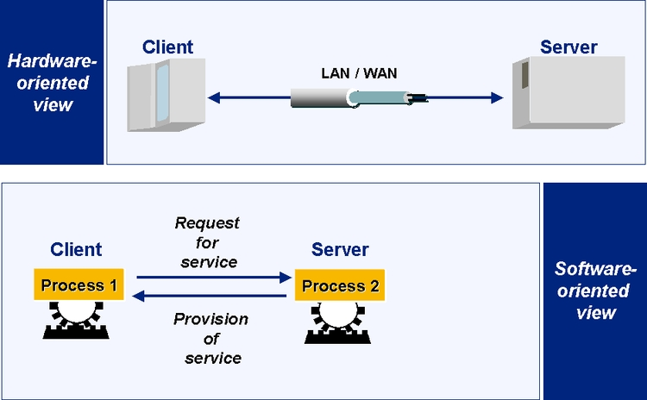
Lesson: Client/Server Architecture
1
Hardware-oriented view

Slide 10
Lesson: Client/Server Architecture
1
Hardware-oriented view
Server: central computer within a network.
Central computer provide data, memory and resource for the workstation and client

Slide 11
Lesson: Client/Server Architecture
2
Software-oriented view

Slide 12
Lesson: Client/Server Architecture
2
Software-oriented view
Service provided by software component.
Software component can be client and server at the same time.

Slide 13
Lesson: Client/Server Architecture
2
Views of client/server configuration
3
Process/Layer for operating business application software
n
Level/tier configuration

Slide 14
Lesson: Client/Server Architecture
3
Presentation-processes
Application-processes
Database-processes

Slide 15
Lesson: Client/Server Architecture
1
Presentation-processes
Eq. displaying screen, GUI

Slide 16
Lesson: Client/Server Architecture
2
Application-processes
Eq. executing application programs

Slide 17
Lesson: Client/Server Architecture
3
Database-processes
Eq. managing and organizing database data

Slide 18
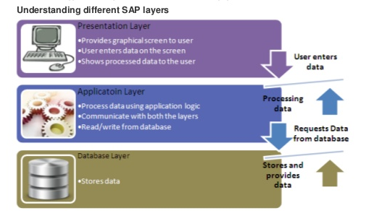

Slide 19
Lesson: Client/Server Architecture
2
Views of client/server configuration
3
Process/Layer for operating business application software
n
Level/tier configuration

Slide 20
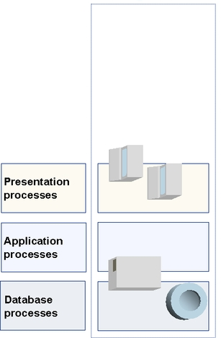
Lesson: Client/Server Architecture
Single-level Configuration
All task done by 1 computer

Slide 21
Lesson: Client/Server Architecture
Single-level Configuration
Presentation, Application and Database performed by one computer
Typical mainframe processing

Slide 22
Lesson: Client/Server Architecture
Single-level Configuration
When this configuration is used?
Test and demonstration

Slide 23
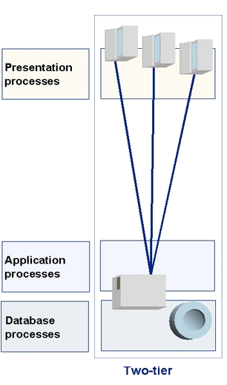
Lesson: Client/Server Architecture
Two-level Configuration
Presentation in one computer
Application and Database performed by another one computer.

Slide 24
Lesson: Client/Server Architecture
Two-level Configuration
What happened when number of user increase? It’s fine.
The load resulting from the presentation process is distributed to the various front-end computers;
The load resulting from the presentation process is not affecting database performance
Notes:
Kalo jumlah user tambah? Ngga masalah. Beban kerja atas proses presentasi kan di distribusikan ke banyak komputer usenya dan tidak mempengaruhi kerja database.

Slide 25
Lesson: Client/Server Architecture
Two-level Configuration
When number of user increase?
It’s fine.
The load resulting from the presentation process is distributed to the various front-end computers;
The load resulting from the presentation process is not affecting database performance
Notes:
Kalo jumlah user tambah? Ngga masalah. Beban kerja atas proses presentasi kan di distribusikan ke banyak komputer usenya dan tidak mempengaruhi kerja database.

Slide 26
Lesson: Client/Server Architecture
Two-level Configuration
SAP GUI runs in?
Presentation
Application
Database
x

Slide 27
Lesson: Client/Server Architecture
Two-level Configuration
Presentation performance influences performance of the Database?
TRUE
FALSE
x

Slide 28
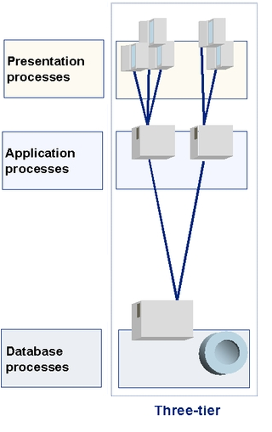
Lesson: Client/Server Architecture
Three-level Configuration
Presentation in one computer
Application performed by another one computer
Database in another one computer

Slide 29
Lesson: Client/Server Architecture
Three-level Configuration
This configuration is easily scalable.
Optimizing performance is executed by adding groups.
One group = One Server = one department

Slide 30
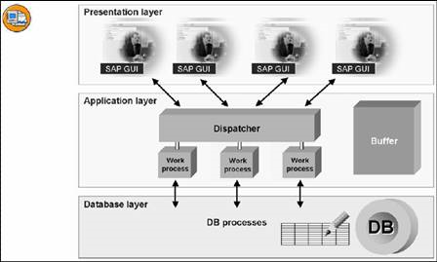
Lesson: Client/Server Architecture
Software-oriented view

Slide 31

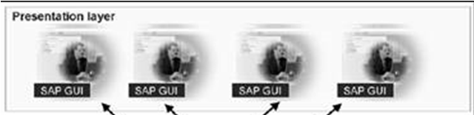
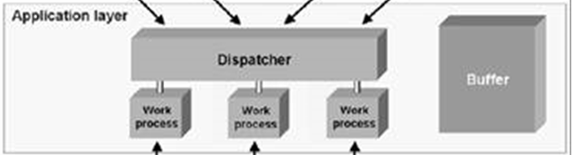
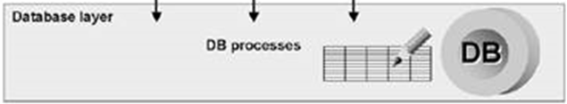
Lesson: Processing of User Request
User entry
receive by
SAP GUI
2. SAP GUI Convert into internal format
7. SAP GUI interpret data and create output screen for user
3. SAP GUI send to
SAP Web Application Server
4. Dispatcher distribute transaction load to work processes.
6. Dispatcher sent the result back to SAP GUI
5. Work process processes data. Processes = read/write from /to databank
Notes:
User mlakukan entry pada SAP GUI
Saat user melakukan klik pada tombol untuk melakukan proses, permintaan user langsung diteruskan ke dispatcher pada SAP Web application server
Permintaan user akan diantrikan oleh dispatcher, proses permintaan dieksekusi FIFO
Dispatcher mendistribusikan permintaan user kepada work process yang available
Work process mengolah permintaan user, apakah membaca atau menuliskan data dari database
Hasil pengolahan dari work process oleh dispatcher dikirim kembali ke SAP GUI
SAP GUI menginterpretasikan data dan menampilkan output pada layar user
Central process in WAS is DISPATCHER.

Slide 32
Lesson: Data Structure of SAP System
3
Data Component
in SAP System

Slide 33
Lesson: Data Structure of SAP System
3
The Client
Customizing setting
The Repository

Slide 34
Lesson: Data Structure of SAP System
1
The Client = client specific data
The data include business data environment, master data and transaction data. Ex: User, material master,etc.
Once logged on to one client, the user has no access to any other client.

Slide 35
Lesson: Data Structure of SAP System
2
Customizing Setting
Client-specific setting
The data include organizational structure, parameter, and default value for SAP transaction.
2. Cross-client setting
The data include public holiday calendar, system change options.

Slide 36
Lesson: Data Structure of SAP System
3
The Repository
The data includes table, data elements, ABAP programs, domains, menu, screen, etc.
Change in Repository apply to all client (cross client).

Slide 37
Lesson: Data Structure of SAP System
Which data components if change affected all client?
The Client
Client specific setting
Cross client setting
The repository

Slide 38
Lesson: Data Structure of SAP System
Which data components if change affected all client?
The Client
Client specific setting
Cross client setting
The repository
x
x

Slide 39
Lesson: Landscape: Change Management
SAP system is standard business software.
What would you do if your company business processes are different form SAP system standard but you want to use SAP system instead?

Slide 40
Lesson: Landscape: Change Management
Customized it!

Slide 41
Lesson: Landscape: Change Management
OK. It can be done.
Changes in “The Repository” apply to all client. Doing this can cause high risk
data loss or inconsistency.
Eq. the repository data are table definition, programs, transaction, function, module

Slide 42
Lesson: Landscape: Change Management
-system landscape
is the solution.
3

Slide 43
Lesson: Landscape: Change Management
3
Development system (DEV)
Quality Assurance system (QAS)
Production system (PROD)

Slide 44
Lesson: Landscape: Change Management
1
Development system (DEV)
Development of customer-specific programs as well as required customizing take place in DEV.
Notes:
Pengembangan program khusus sesuai kebutuhan pelanggan maupun membuat perubahan dan penyesuaian yang dibutuhkan berlangsung di DEV.

Slide 45
Lesson: Landscape: Change Management
2
Quality Assurance system (QAS)
Development and changes are transported to QAS to be checked without influencing the production.
Notes:
Hasil program dan perubahan yang telah dibuat di pindahkan ke QAS untuk dilakukan pengecekkan atau pengujian apakah program sesuai atau tidak.

Slide 46
Lesson: Landscape: Change Management
3
Production system (PROD)
The tested and approved object are transported to the test system (copy of production system). The final transport is into PROD.
Notes:
Objek diuji dan disetujui diangkut ke sistem tes (salinan dari sistem produksi). Transportasi terakhir adalah ke PROD.

Slide 47
AGENDA
Lesson: mySAP Technology
Client Server Architecture
Reference:
SAP. (2006). SAP01: SAP Overview. SAP AG.
The Database

Slide 48
Indikator Kajian 3
Materi Bahasan yang Diujikan | Kriteria Penilaian
 | Tidak Lulus (0-5) | Dasar (6-10) | Menengah (11-15) | Cukup Mahir (16-20) | Mahir (21-25)
Human Capital Management (HCM) | Tidak memenuhi kriteria penilaian kompetensi dasar | Menyebutkan dan mendefinisikan SEBAGIAN BESAR organizational elemen dan master data di HCM(C1) | Menyebutkan dan mendefinisikan SELURUH siklus perencanaan produksi&proses produksi dan dokumen yang dihasilkan (C1) | Memberikan contoh kegiatan dan output berupa nama document dari siklus perencanaan produksi&proses produksi (C2) | Membuktikan dalam sebuah studi kasus tentang proses perencanaan produksi&proses produksi (C3)
Arsitektur client server, struktur data dan manajemen perubahan dalam sistem ERP | Tidak memenuhi kriteria penilaian kompetensi dasar | Menyebutkan dan mendefinisikan jenis sudut pandang (view) client/server dan/atau level Client/Server configuration dan/atau proses/layer. (C1) | Menjelaskan level Client/Server configuration berdasarkan pembagian proses/layer dan cara meningkatkan performansi client/server ini (C2) | Menjelaskan three-system Lanscape facilities. (C2) | Menganalisis pemrosesan permintaan dari user (Processing of User Request) (C3).
Basis Data: Transaksi, ABAP dictionary, SAP business object, dan SAP business framwork dalam sistem ERP | Tidak memenuhi kriteria penilaian kompetensi dasar | Menyebutkan 4 prinsip dari transaksi (C1) | Menyebutkan komponen dari ABAP Dictionary, SAP business object, dan SAP business framwork (C1) | Menyebutkan definisi/kegunaan dari ABAP Dictionary, SAP business object, dan SAP business framwork (C1) | Menjelaskan fungsi/definisi dari bagian pembentuk ABAP Dictionary, SAP business object, dan SAP business framwork (C2)
Human Capital Management dan mySAP technology | Tidak memenuhi kriteria penilaian kompetensi dasar | Mempertunjukkan transaksi yang diakses untuk menyelesaikan studi kasus (P2) | Mempraktekkan SEBAGIAN siklus dan SEBAGIAN data SESUAI dengan studi kasus (P3) | Mempraktekkan SEBAGIAN siklus dan SELURUH data SESUAI dengan studi kasus (P3) | Mempraktekkan SELURUH siklus dan SELURUH data SESUAI dengan studi kasus (P3)

Slide 49
Unit 7: mySAP Technology
Unit Overview
mySAP.com e-business platform is supported by an open integration architecture.
mySAP technology is build on fundamental industry standard to ensure openness and interoperability. (eq. HTTP, XML)
Flexibility framework in SAP allows to deliver e-business solution tailored to the needs of customer and their business partner.

Slide 50
Unit 7: mySAP Technology
Unit Objectives
Multi tier client/server concept
SAP client/server concept
Function client, client/server, server in software oriented view in SAP
Hardware system configuration
The purpose of client in term of mater, customizing, application data
Feature of development, a QA system, a production system and form of stage of live-system rollout
How business transaction related to system application
Requirement of entering in text field and assigning attribute
How table are used to identify the schematic and technical characteristics of fields
View the content of tables in SAP database
How table are used to generate specific information

Slide 51
Lesson: The Database
Lesson Overview
The term SAP transaction is define
Central component of ABAP workbench, the ABAP dictionary and how you can display the sales order in a table
Lesson Objectives
Describe how business transaction relate to system application
Define requirement for entering in text fields, as well as assigning attribute
Describe how table are used to identify the semantic and technical characteristics of fields
View the content of a table in SAP database
Describe how table are used to genera specific information

Slide 52
Lesson: The Database
Transaction
are processing unit grouped to provide specific function.

Slide 53
Lesson: The Database
Transaction
are processing unit grouped to provide specific function.

Slide 54
Lesson: The Database
4
Principal character Transaction
Atomic
Consistent
Isolated
Durable

Slide 55
Lesson: The Database
ABAP Dictionary contain Field Definition
Basic object for defining data in ABAP Dictionary
Tables
Data elements = is used for semantic definition (field label) of a table field
Domains = is used for technical definition (field type, length) of a table field.
Field depends on table.
Field definition is the smallest unit for representing business-related information.
Field definition contain length of the field, type of character, number interval etc.
Notes:
Field definition contain length of the field, type of character, number interval etc. = field definition

Slide 56
Lesson: The Database
Where is Field Definition stored?
ABAP Dictionary

Slide 57
Lesson: The Database
Data records in the Table

Slide 58
Lesson: The Database
SAP Business Object is representation of a central business object in the real world (eq. employee, sales order, purchase requisition, invoice)
Business object = tables attribute+ application program (method)
Application program = method of the business object
Attribute = characteristics that specify the
business object.
Attribute and method are assigned to business object
Attribute can be modified by the method.
Business objects are maintained in Business Object Repository
Notes:
Business object is composed of tables related in business context including the related application program

Slide 59
Lesson: The Database
SAP Business Framework
Framework to allow the technical integration and exchange of business data among SAP component and between SAP and non-SAP component.
Basic component of Business Framework
Business component
Business object type
BAPI
Application Link Enabling (ALE)

Slide 60
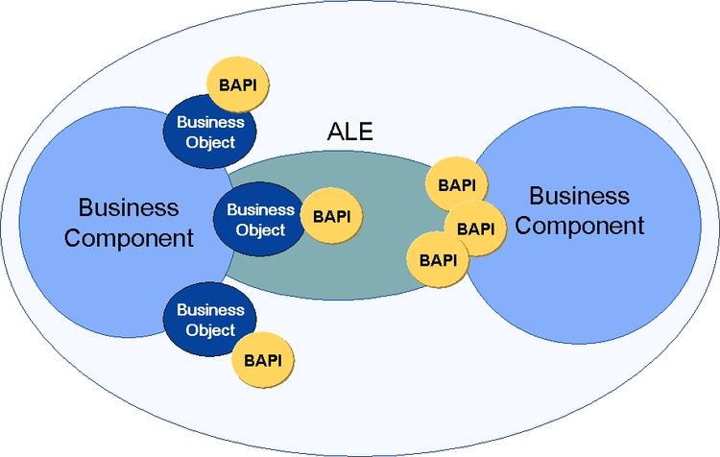
Lesson: The Database
Basic component of Business Framework

Slide 61
Lesson: The Database
Basic component of Business Framework
SAP business component: provide autonomous business function;
consists of business object.
Ingat! Contoh business object = employee, sales order
Business Object
Business Component
Business Object
Business Object
Notes:
Penyedia berbagai fungsi bisnis dan terdiri dari beberapa business object

Slide 62
Lesson: The Database
Example Business Framework
Business Object
Business Component
Employee
Business Object
Applicant
Human Resource
Business Object

Slide 63
Lesson: The Database
Basic component of Business Framework
BAPI
The Business Application Programming interfaces (BAPIs) enables you to integrate external software into SAP system or between SAP system.
How to integrate? Using Business object method.
BAPI define and document the interface standard at the business level.
Ingat! Business object =tables attribute + application program (method)
Business Object
Business Component
Business Object
BAPI
Business Object
BAPI

Slide 64
Lesson: The Database
Basic component of Business Framework
BAPI
Business Object
Application Link Enabling (ALE) integration service enable the technical integration of business process that carried out in different SAP and non SAP system.
ALE integration service distributes business object type across the system using ALE distribution model.
Business Component
ALE
Business Object
BAPI

Slide 65

End of This Session

Slide 66
End of This Session

